Slide 1

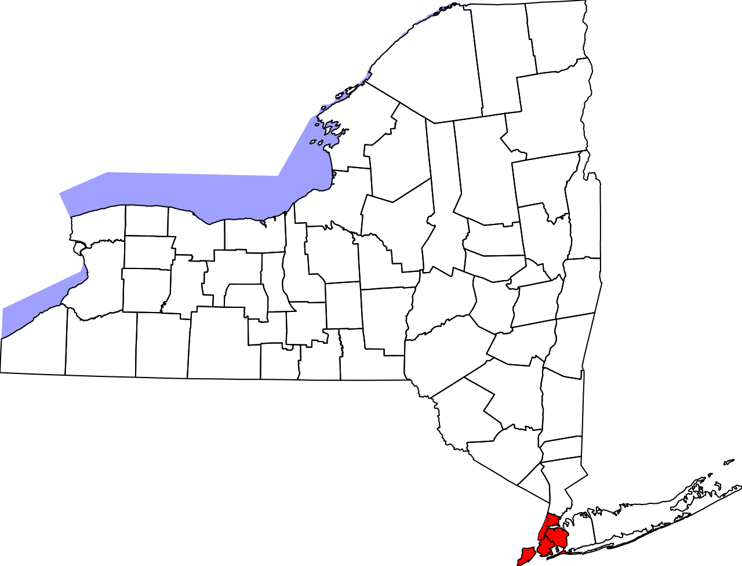
NYPD Civilian Complaints
Presenters:
Francis Olave
Caleb Moore
Matthew Granson

Slide 2
Motivation & Interest
We chose this topic initially due to convenience, but given the recent events over the past year, which lead to our interest in the behavior of police.
Given the protests and COVID-19 policies, we were curious to see some of the civilian complaints regarding the NYPD, hosted by a one of the hardest-hit states early on in the pandemic.

Slide 3
Questions & Data
We decided to investigate three major themes:
The command units with the most amount of civilian complaints
The complaint frequency of individual officers from those units
The nature of alleged aggressions being reported

Slide 4
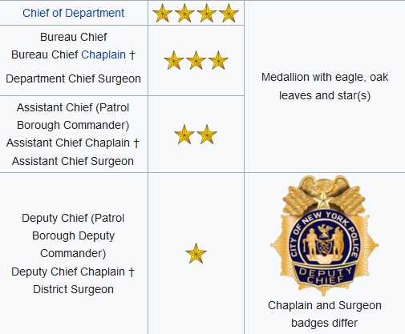
NYPD Ranks

Slide 5
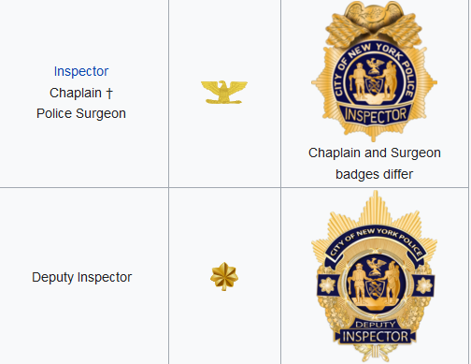
NYPD Ranks

Slide 6
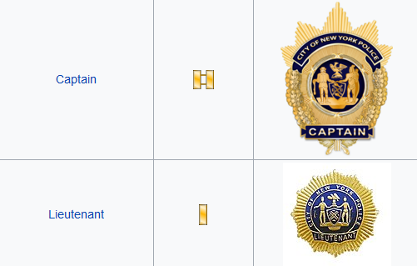
NYPD Ranks

Slide 7
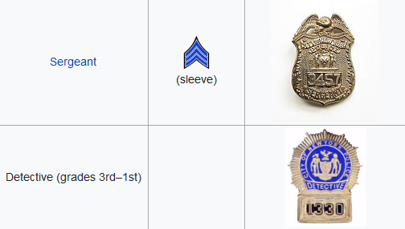
NYPD Ranks

Slide 8
Keywords
The following abbreviations are related to individual ranks within a division (highest to lowest).
LT: Lieutenant
SGT: Sergeant
SDS: Supervisor Detective Squad
DT1 - 3: Detectives (Grades 1-3)
POM: Public Order Management (protests)

Slide 9
Keywords: Detectives (DT3-1)
In the NYPD, the detective rank is split into 3 smaller “grades” (grade 3 being the lowest).
A detective that achieves the rank of sergeant can progress to an SDS (supervisor detective squad) role in which they supervise a group of detectives and affiliate officers.

Slide 10
Keywords: Public Order Management (POM)
Police officers assigned to keeping order and maintaining protests.
Given permission to “suppress” violent activity to avoid riots and mob-like behavior.

Slide 11
Keywords: Criminal Intelligence Section (INT CIS)
Collect and maintain data regarding criminal and terrorist activity
Assigns field intelligence officers to collect and disseminate info regarding narcotics and criminal investigations

Slide 12
Keywords: Warrant Sector (WARRSEC)
Receiving, maintaining, and distributing arrest warrants to suspected individuals
Provides warrants to detectives and other units to aid in investigative efforts (i.e. warrants to enter the premises)

Slide 13
Keywords: Internal Affairs Bureau (IAB)
A division of law enforcement that investigates incidents and possible suspicions of law-breaking and professional misconduct attributed to police officers on the force.

Slide 14
Data Cleanup & Exploration
Dropped the null values from the relative columns in the data set:
Unique ID
Fado Type
Year
Command
Rank
Separated the data into different data frames categorized by command:
All narcotics commands
Warrant Section
Intelligence
Internal Affairs
Precinct 075

Slide 15

Data Cleanup & Exploration
To analyze the total number of substantiated complaints, we attempted to remove duplicate entries of complaints and keep only the unique complaint id numbers. Unfortunately, the curators of this data set have many unique complaint id’s entered multiple times with different board dispositions/outcomes. We instead looked at just substantiated complaints compared to the total.

Slide 16
Total Complaints
Out of 323,907 total complaints, only 20,826 were listed as “substantiated”, or 6%.

Slide 17
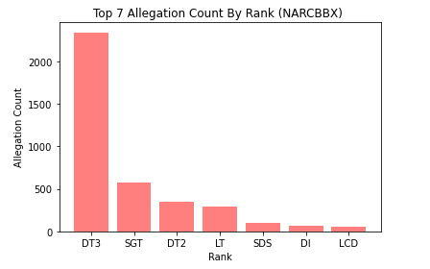
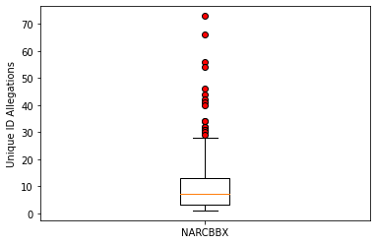
Findings: NARCBBX
Narcotics Borough Bronx

Slide 18
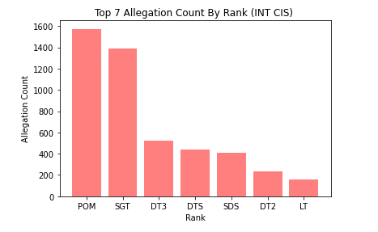
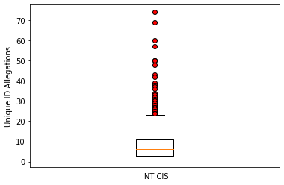
Findings: INT CIS
Intelligence

Slide 19
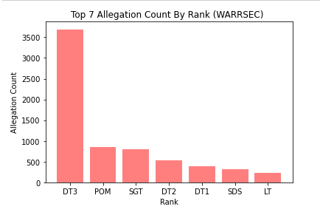
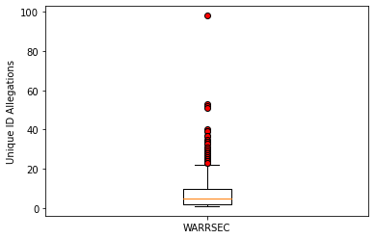
Findings: WarrSec
Warrant Section

Slide 20
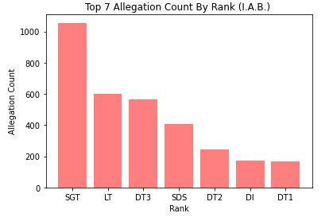
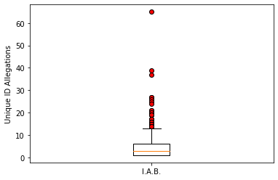
Findings: I.A.B
Internal Affairs Bureau

Slide 21
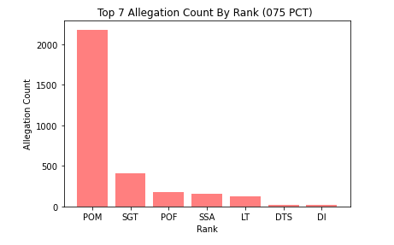
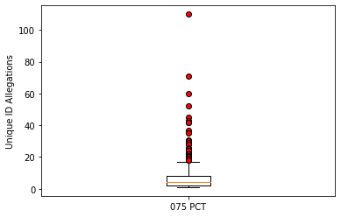
Findings: PCT 075
Precinct 75

Slide 22
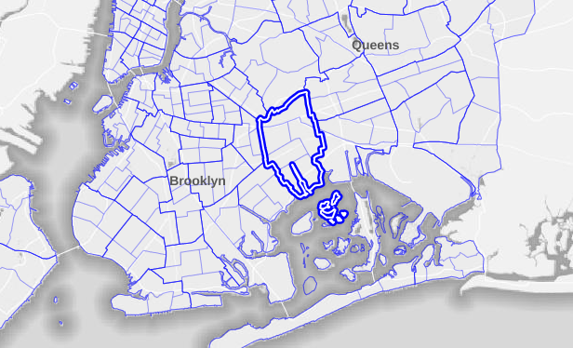
Precinct 075
https://theintercept.com/2020/08/23/nypd-75th-precinct-police-misconduct/

Slide 23
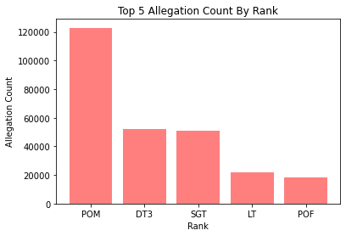
Findings: Allegations by Rank
POM: 122,872
DT3: 52,341
SGT: 50,632
LT: 21,896
POF: 18,075

Slide 24
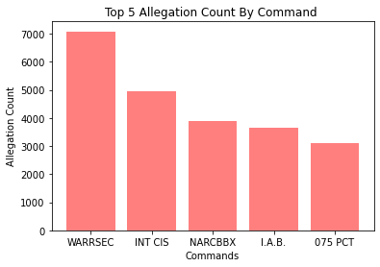
Findings: Allegations by Command
WARRSEC: 7,082
INT CIS: 4,958
NARCBBX: 3,888
I.A.B. : 3,647
075 PCT: 3,090

Slide 25
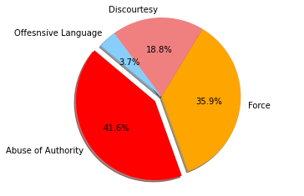
Topics of Interest: FADO Type
Force: Pushing, dragging, chokeholds, gun drawn.
Abuse of Authority: Unwarranted frisking or entering a premises, refusing to provide identifying info.
Discourtesy: Cursing, slurs, and profane gestures.
Offensive language: Remarks regarding ethnicity, race, sexual orientation, religion or gender.

Slide 26
Topics of Interest: Alleged Behavior
Sometimes, a submitted complaint will include additional info detailing the specific behavior an officer exhibited that warranted the complaint in the first place.
Here are a few of the more eye-catching aggressions:
Officer 7927 LT - “Forcible removal to hospital”
Officer 392 POM - “Animal”, “Nan”
Officer 19396 POM - “Radio as a club”
Officer 17802 DT3 - “Electronic device information deletion”
Officer 17802 DT3- “Search for recording device”

Slide 27
Topics of Interest: Officer 4468 DT3 (1987-2003)
171 complaints
55 complaints regarding “Abuse of Authority”
Most involving the unwarranted searching of a person or premises
16 counts of property damage
26 complaints regarding “Discourtesy”
Mostly complaints of cursing and “Nasty Words”
86 complaints regarding “Force”
Weapon of choice seems to be “flashlight as a club”
Often slaps or drags individuals
4 complaints regarding “Offensive language”
All of these were ethnic slurs

Slide 28
Hypothesis 1: Lower ranked officers will receive more complaints than higher ranked officers.
Reasoning: Due to inexperience with the job, we hypothesized that lower ranked officers (with less time in the field) would behave in a way reminiscent of the “Rookie cop” stereotype. Prone to knee-jerk reactions, panicked outbursts due to fear, and a sudden sense of superiority obtained with the new uniform.
Result: Hypothesis Supported
Results showed that officers ranked as “Detective grade 3” (DT3) and received the vast majority of complaints for the NARCBBX and WARRSEC command units.
DT3’s also received the third highest amount of complaints in the IAB and INT CIS command units
Officers ranks as Public Order Management (POM) received the highest amount of complaints for the INT CIS and Precint 75 untis

Slide 29
Hypothesis 1: Lower ranked officers will receive more complaints than higher ranked officers.
Discussion:
DT3 and POM are the lowest ranks in the NYPD command structure just above “police officer” which is the literal bottom rank.
Given that POM officers are assigned to maintain protests and DT3 are required to be more investigative, it makes sense that officers of these ranks would garner more complaints throughout their careers. These two lines of work are much more high stress than basic patrol duty.

Slide 30
Hypothesis 2: NARCBBX officers will exhibit a larger amount of allegations compared to other police command divisions.
Reasoning: Due to the fact that many Narcotic officers have been experienced in trained law enforcement and have the expertise in every situation and handle it the rightful way. We believe that due to that they have the most allegations because they take advantage of the power they have instead of implementing the principles they were taught. Subject matter dealt with by NARC command units is usually more violent and unpredictable than those of the IAB and WARRSEC. NARC officers are usually tasked with hunting down and locating contraband produced/distributed by known criminals.
Result: Hypothesis Not Supported
In our findings we see that the Narcotic command had the third highest complaints therefore our hypothesis was not supported.

Slide 31
Hypothesis 2: NARCBBX officers will exhibit a larger amount of allegations compared to other police command divisions.
Discussion: WIth WARRSEC (Warrant Sector) they are more of the public unit than the Narcotic unit meaning they deal with more people giving out warrants for their arrests. Some of those arrest could be wrongfully made leading to people making more complaints towards them.

Slide 32
Summary
Narcotics Command had the third-most complaints of any command
DT3 and POM were the lowest ranks with the highest majority of allegations
May have been influenced by the protests in the preceding year

Slide 33
Limitations
No data set is perfect. With regards to the NYPD MoS Records, the data was lacking basic demographic info including the officers age, gender and ethnicity.
Additionally, it should be noted that many complaints are classified as unsubstantiated most likely due to a lack of contextual information. This is especially true with complaints regarding discourtesy. Evidence regarding the overt or subtle actions of an officer are mostly hearsay without recordings of the incident. More data regarding the presence of body cam equipment would be beneficial.
Despite the large sample size of the dataset, this volume of data should not be seen as representative of all police officers.

Slide 34
Questions?
Open to the class!

Slide 35
References
NYCLU GitHub Repository
https://github.com/new-york-civil-liberties-union/NYPD-Misconduct-Complaint-Database
NYPD Command Structure
https://en.wikipedia.org/wiki/New_York_City_Police_Department

